Slide 1
Git 101
Or: Git for Gits
David Muckle

Slide 2
What is Git?
VCS (Version Control Software)
CVS, Mercurial, Git
Keep track of changes
Revert back to old changes
Keep multiple versions of a project
Merge versions
Synchronize projects between machines
Keep your project “in the cloud”

Slide 3
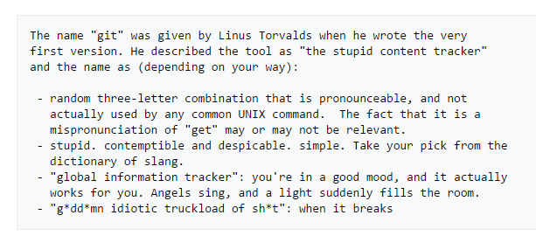


History of Git
Use in Linux development
Replacing BitKeeper
Use online
GitHub, BitBucket

Slide 4
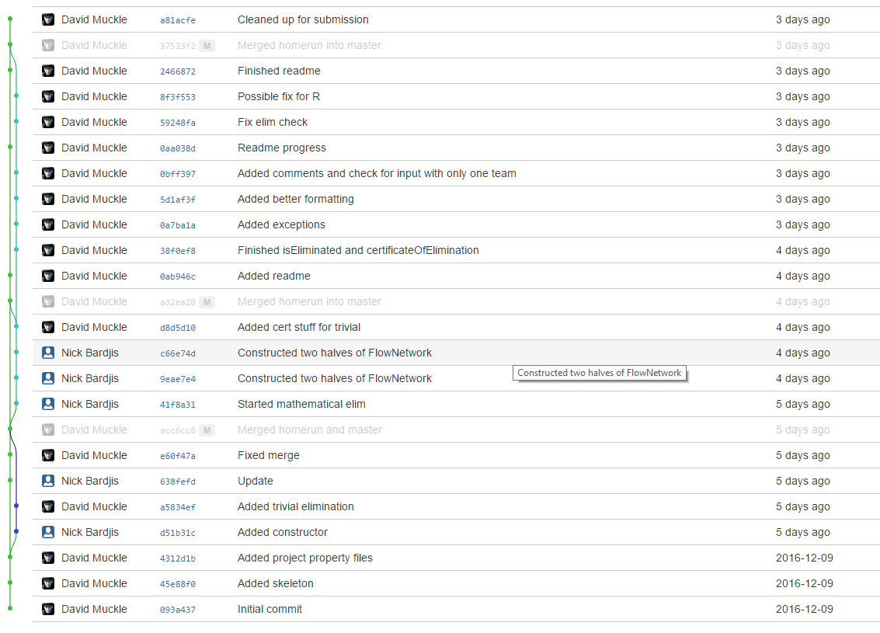
The Git Basics
git init
git clone {repo url}
Use http or ssh
git add somefile.thing
git status
git commit {-m ‘Comment’}
git push
git pull
git branch branchname
git checkout branchname
git merge

Slide 5
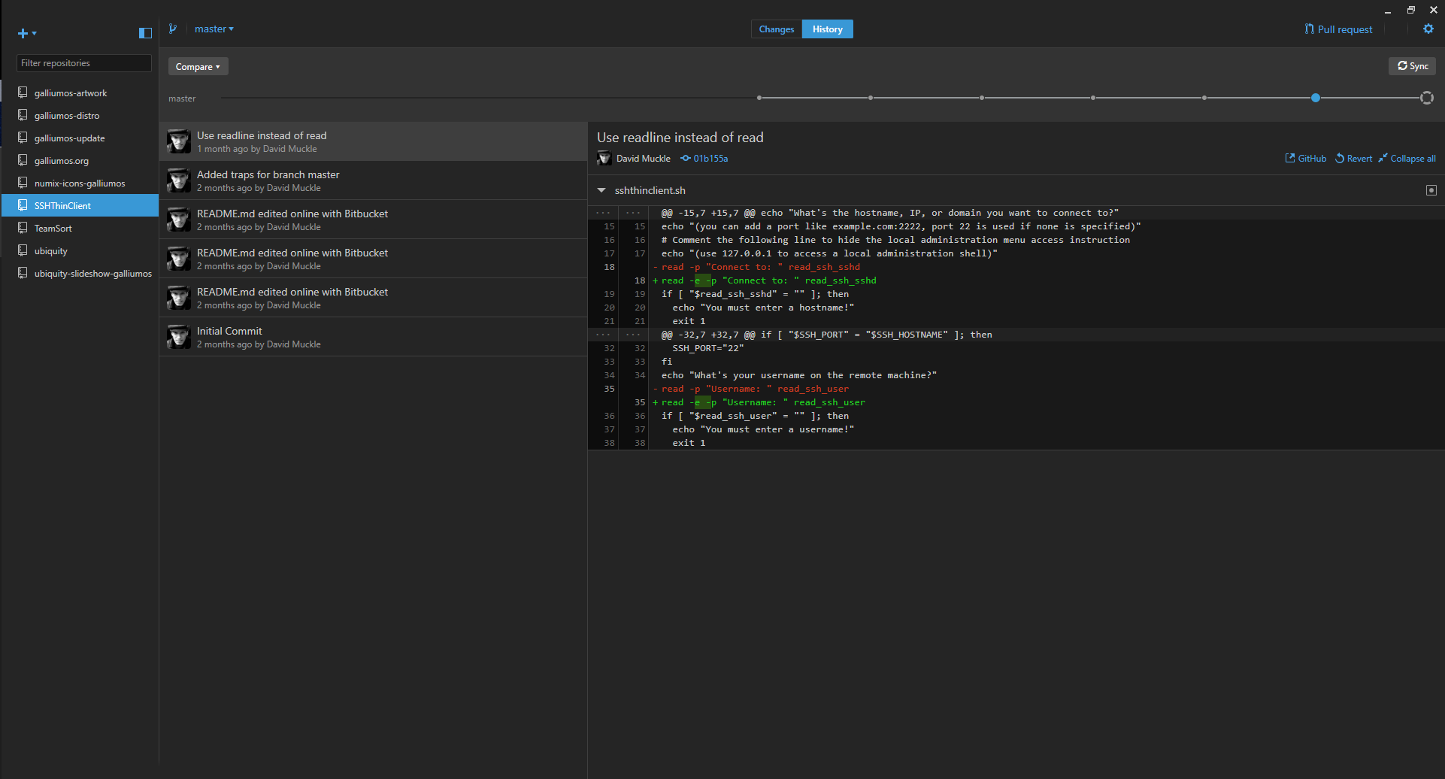
Graphical Clients
Integration with IDEs
Eclipse, Netbeans, IntelliJ
Standalone Clients
GitHub Client, Atlassian SourceTree, Git GUI

Slide 6
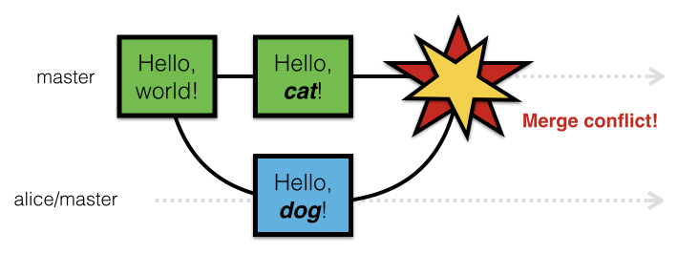
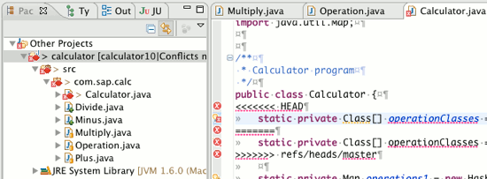
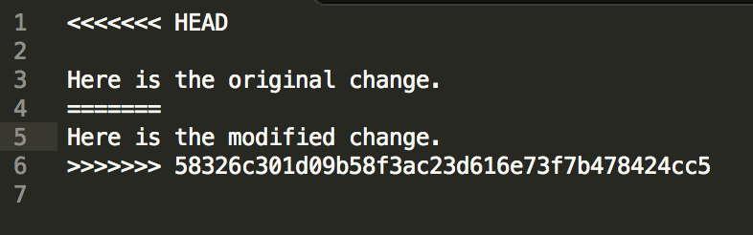
What to do if Git breaks

Slide 7


Slide 8
Resolving Merge Conflicts
Stay calm
Read the marked changes
Talk with your partner(s)
Figure out what to keep
Edit accordingly
Push changes

Slide 9
Using with your Clark CS Account
Create a repository on system
Commit changes
On local computer, git clone ssh://{username}@csgateway.clarku.edu/home/{username}/{pathtorepo}
Won’t work with pair programming

Slide 10
Suggested Setup for Pair Programming
Use BitBucket
Create repository with private access
Add members to repository
OR
Create team with partner
Create repository under team

Slide 11
Can I use Git for other things?
Absolutely!
Essays
Cover letters
Image editing
Recipes

Slide 12
Go forth and Commit!

